Slide 1

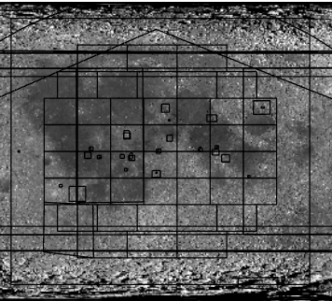
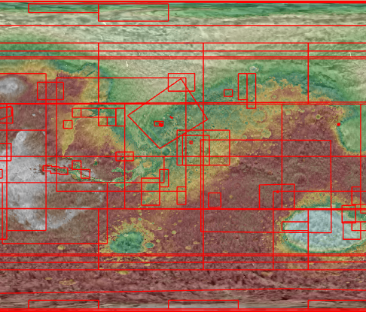
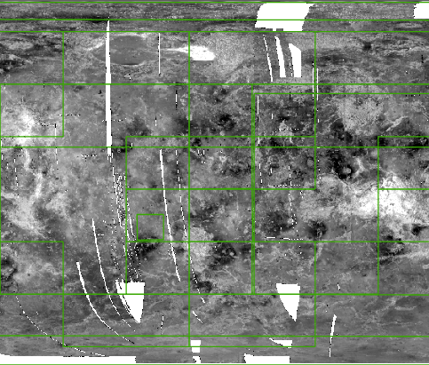
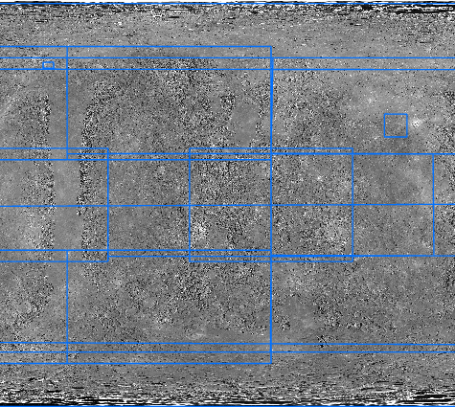



Constructing a Comprehensive Database of Planetary Maps
Sam Phippen
sjp368@nau.edu
samphippen27@gmail.com
NAU-NASA Space Grant
USGS Astrogeology Science Center
Dr. Sarah Black: sblack@usgs.gov
Sonya Bogle: sbogle@usgs.gov
Rachel Fry: rfry@usgs.gov
Preliminary Information – Subject to Revision. Not for Citation or Distribution.
Notes:
Hi there, my name is Sam Phippen, I’m an undergraduate researcher at NAU under the NAU-NASA Space Grant, and today I’m going to present the work I’ve done with my colleagues at the USGS Astrogeology Science Center to help construct a comprehensive database of planetary maps.

Slide 2


Why?
Notes:
To start- let’s explain why we need to create this database. While it may seem trivial or boring, being able to find planetary geologic maps all in one place has been a long-standing topic of interest for the planetary science community.
Imagine you’re a planetary geologist, and you want to make a map. If you’re making a map, the first thing you’d want to do is find any other maps that have already been made of your region.

Slide 3
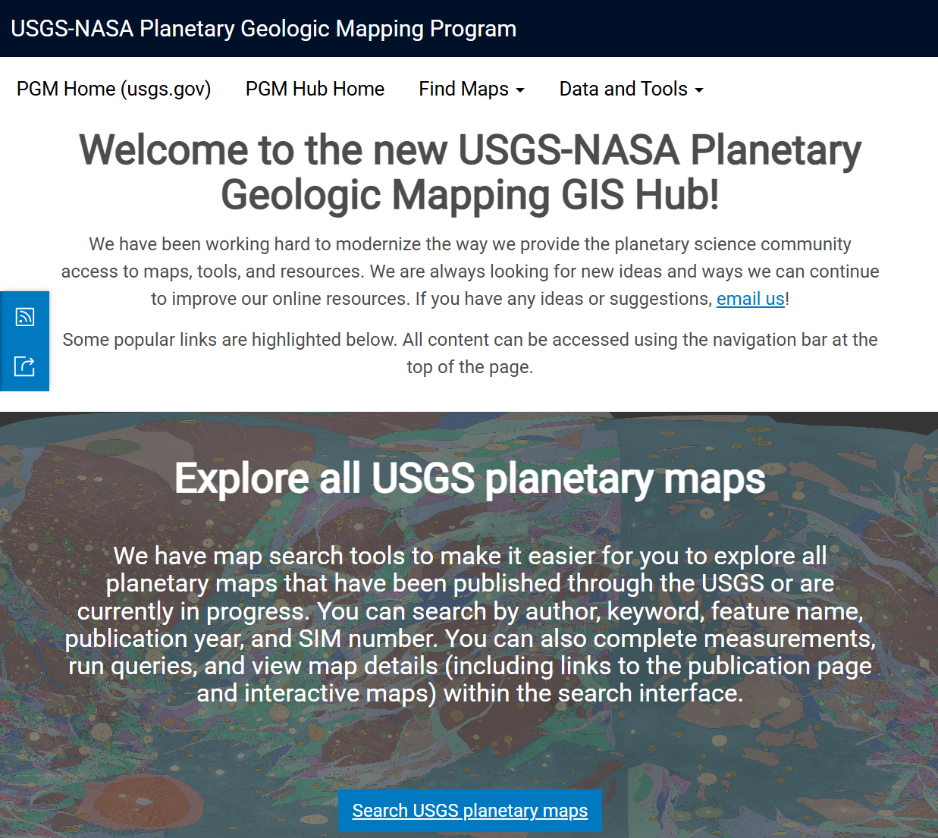
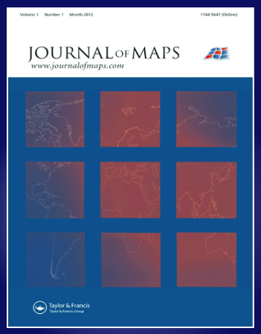
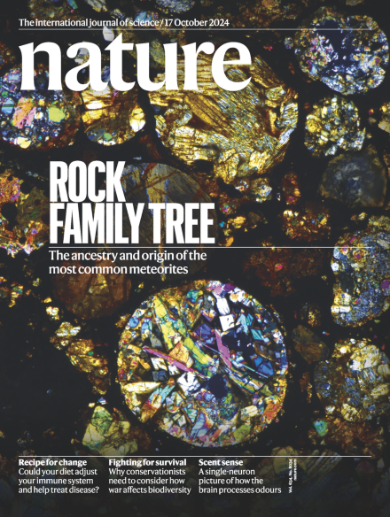


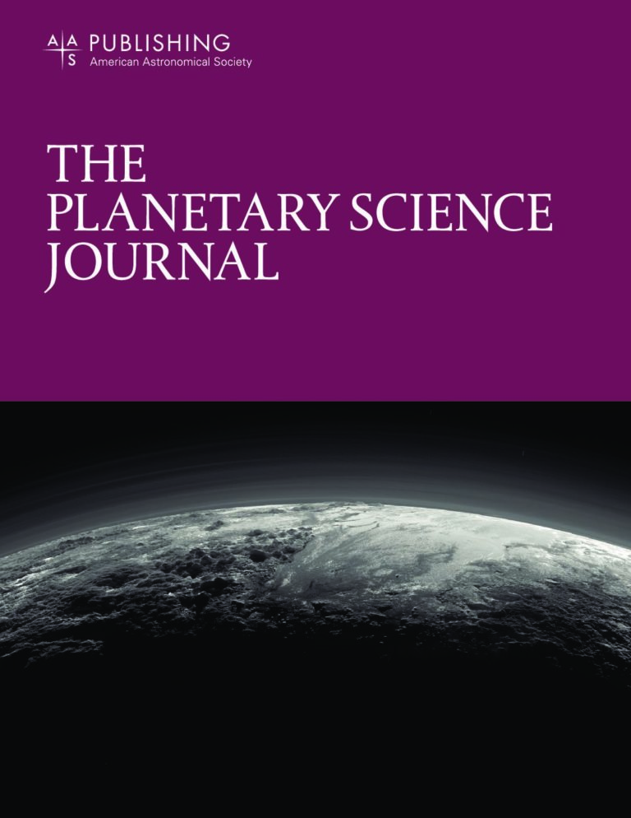
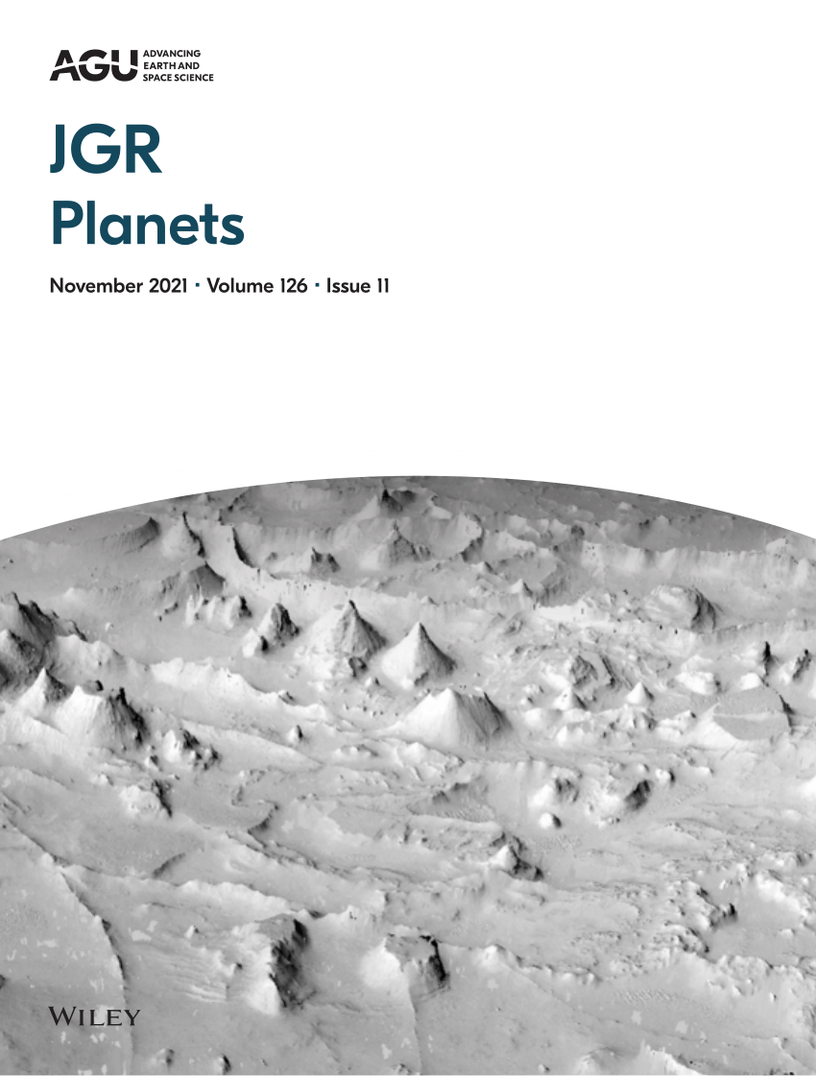
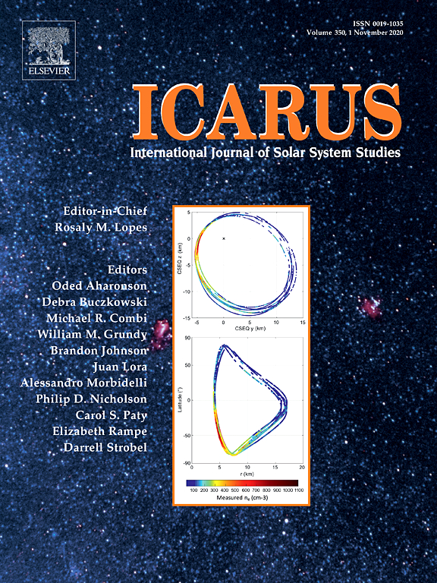
Planetary Map Sources
USGS-NASA
PGM Hub
Scholarly Journals
Notes:
You’ll find quickly after googling that there are two primary ways that maps are currently published- either through the USGS-NASA Planetary Geologic Mapping Program, or via scholarly journals.

Slide 4



PGM-Hub
Search spatially or by text
Data + Resources
Notes:
The USGS-NASA Planetary Geologic Mapping Program ArcGIS Hub (or PGM-Hub, as I’ll call it from here on out) allows for people to search for maps by planetary location and other categories. Most notable are the spatial search capabilities of the PGM Hub-. This hub also includes other tools and links to resources, like GIS data, and interactive maps. While the PGM hub offers robust search capabilities and standardization, far from every planetary map is published through the USGS- there are TONS of other great planetary maps out there.

Slide 5



Scholarly Journals
Search by text
Needle in a haystack
Notes:
The other way to find planetary geologic maps is by looking through scholarly journals. Individual journals also offer search options, though they’re lacking when it comes to spatial searching capabilities. It should also be noted that because publishing requirements vary based on the journal, there is much less standardization between maps published this way. Journal-published maps made in the same area could have vastly different titles, be split between multiple journals (one in Icarus, another in PSJ, for example), and have other publishing and metadata inconsistencies- leading to a bit of a needle in the haystack situation when it comes to searching through maps published via this avenue.

Slide 6

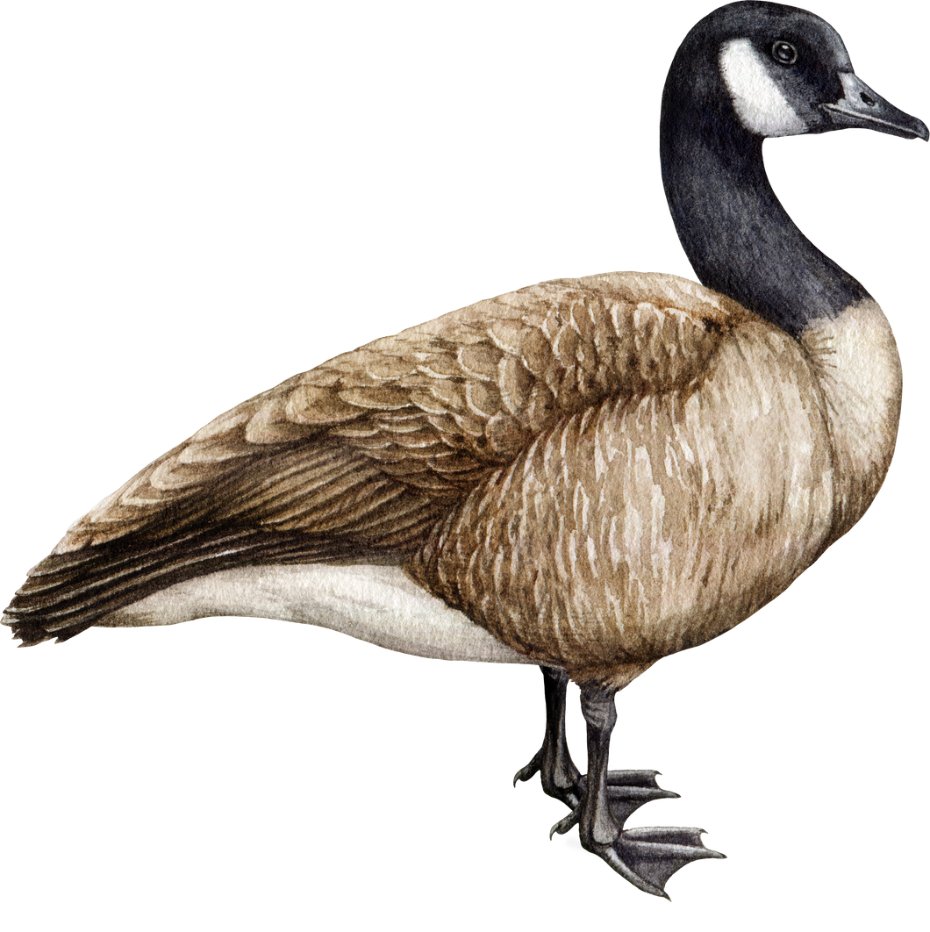
Planetary Map Sources Pros + Cons
Scholarly Journals
USGS-NASA
PGM Hub
Spatial Search
Standardization
All-in-one source
Not Comprehensive
Text Search
Not Standardized
Plethora of sources
HUGE Variety
Notes:
So, while planetary geologic maps are abundant, they are not always easy to find- causing researchers to often go on wild goose chases just to find the right avenue to search for their target map. Then, once they’ve narrowed down their sources to search from, they have to decide what their priorities are while searching. You could try to narrow down your search by text-based searching through of individual journal websites… but without the spatial context available to zoom into your area, click a few buttons, and see every map you need pop up- this makes finding existing map products for an area extremely time consuming. However, if you only use the PGM-Hub, you’re missing out on tons of non-USGS maps that you could use for your research.

Slide 7
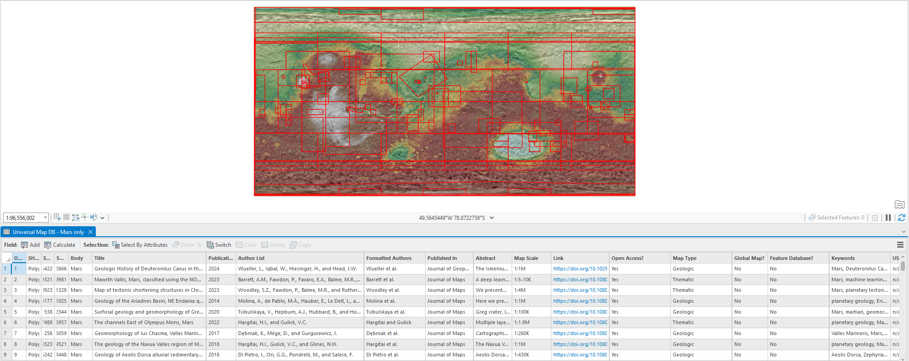
Comprehensive Database
Spatial Search
Tons of Journal Maps
Notes:
To combat these issues, we’re now creating a database that combines the spatial search functionality of the PGM hub with the vast amounts of published maps from journals. We’re doing the tedious work of finding every planetary map for a body within a given published journal, and then adding that map’s information and footprint to a spatially referenced database in ArcGIS Pro- which you can see in the image on the right. Below are some examples of the fields and data that are input with each footprint.

Slide 8
Current Database Work
Inner planets to start
Mercury
Venus
Moon
Mars
Journals of choice
Journal of Maps
JGR Planets
Nature
Icarus
PSJ
GRL
Notes:
To keep our scope in check, our goal was to start the database process with just the inner terrestrial planets- Mercury, Venus, the Moon, and Mars. To do this, we combed through # (5 or 6 journals I think? Double check this lol) journals- Icarus, JGR, PSJ, Nature, and etc etc.

Slide 9
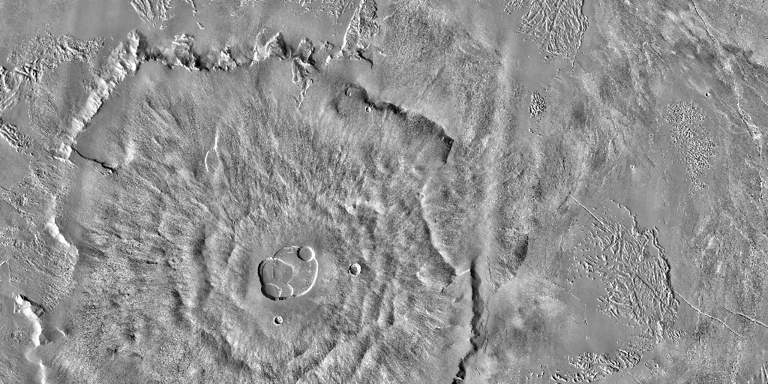
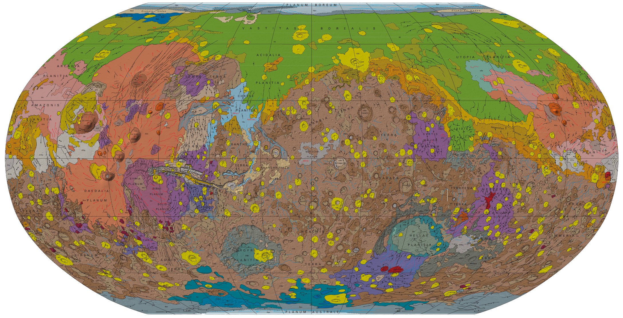
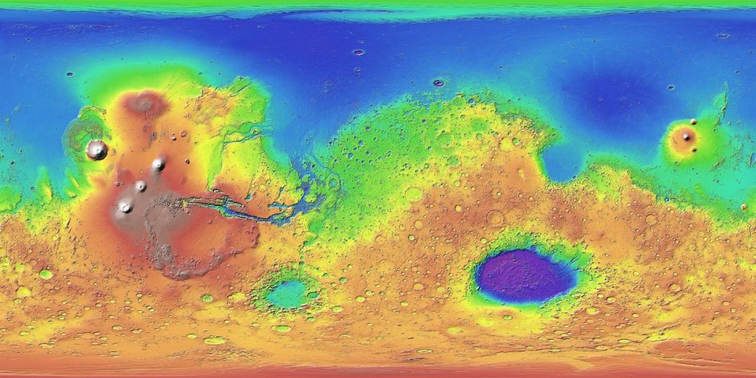
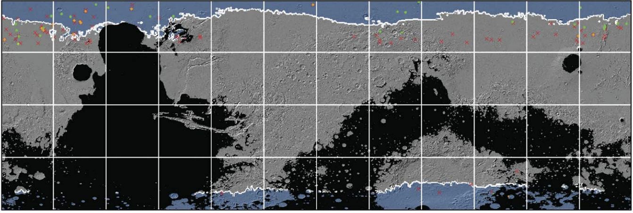
Current Database Work
Basemap Data
Thematic/Geologic Maps
Mars Odyssey THEMIS-IR Day Global Mosaic 100m v12, THEMIS Team ASU
Geologic Map of Mars, Tanaka et al.
Mars MGS MOLA Global Color Shaded Relief 463m, USGS, NASA GSCF
Refined Mapping of Surface Water Ice on Mars to Support Future Missions, Morgan et al.
Notes:
We also specifically targeted thematic or geologic maps (like this Martian ice mapping, for example) to add to our database. While it may seem tempting to include basemaps in this database, like DEMs and hillshade data, so that all of the data can be in one spot, we decided not to, as much more robust search tools already exist for these planetary data- such as Astropedia.

Slide 10
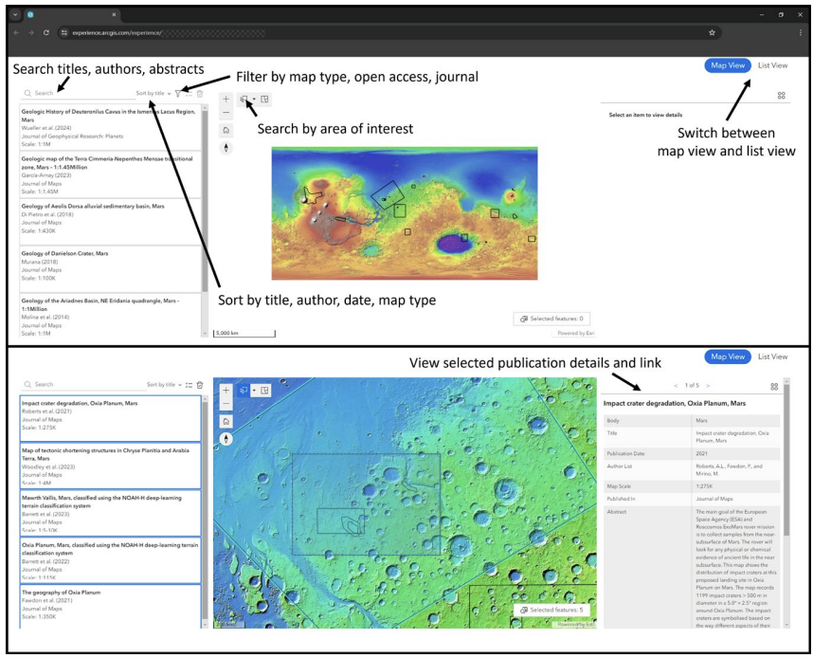

Future Database Work
Outer bodies next
Jupiter
Saturn
Uranus
Neptune
Pluto
Database online format
Notes:
Moving forward, we hope to continue our collection of geologic map data by expanding the work to the outer bodies of the solar system. Eventually, the database will be posted online for anyone to use, and hopefully, will make finding planetary geologic maps much, much easier.

Slide 11
Thank you! Questions? sjp368@nau.edu
Sam Phippen
sjp368@nau.edu
samphippen27@gmail.com
NAU-NASA Space Grant
USGS Astrogeology Science Center
Dr. Sarah Black: sblack@usgs.gov
Sonya Bogle: sbogle@usgs.gov
Rachel Fry: rfry@usgs.gov
Notes:
Here’s my contact information, as well as my colleagues at the USGS’s information if you’d like to reach us with any comments or questions. Thank you so much!

